Slide 1
Chapter 5
Fiber sensor

Slide 2
In the preface, we have introduced the fiber sensors briefly.
The fiber sensors can be divided into the following two types:
Fiber Bragg grating based fiber sensors
    Single-point fiber sensor
    Multi-point (quasi-distributed) fiber sensor
(2) Distributed fiber sensors
Fiber Bragg grating based fiber sensors
Applications
Railway monitoring
Bridge monitoring

Slide 3
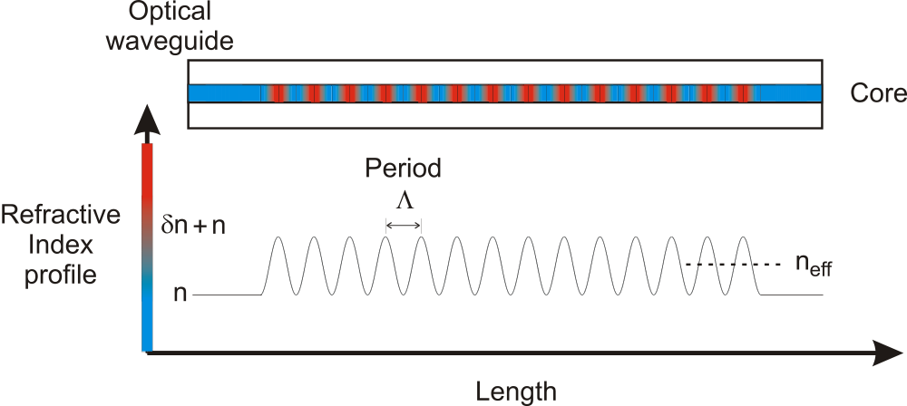
Fiber Bragg grating based fiber sensors
What is the fiber Bragg grating?
The refractive index of the fiber core is modulated in a certain way.

Slide 4
When a Ge-doped silica core fiber is exposed to UV light (λ =190-266 nm), this leads to a change in refractive index (Δn) of the exposed region of the fibre.
Photosensitivity:
UV exposed Ge-doped silica fibre Δn =10⁻⁴
UV exposed B/Ge-doped silica fibre Δn =10⁻³
UV exposed H₂-loaded B/Ge-doped silica fibre Δn =10⁻²
This can be utilized to UV-write Bragg grating structures in fibers.

Slide 5
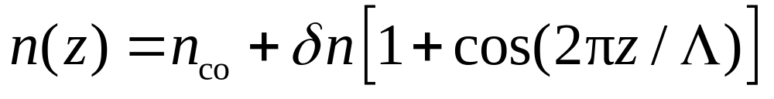
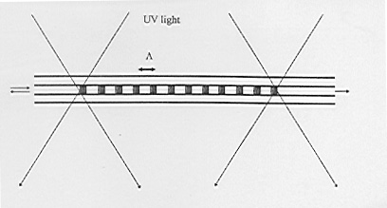
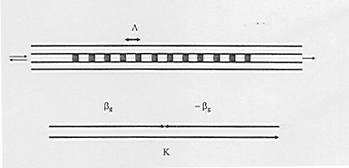
Fibre Bragg grating (FBG) - periodic index modulation in fiber core
Such structures can couple the light from the forward propagating mode (β_{g}) to the backward propagating mode (-β_{g}) when they are phase matched-forming reflection at resonant wavelength.

Slide 6
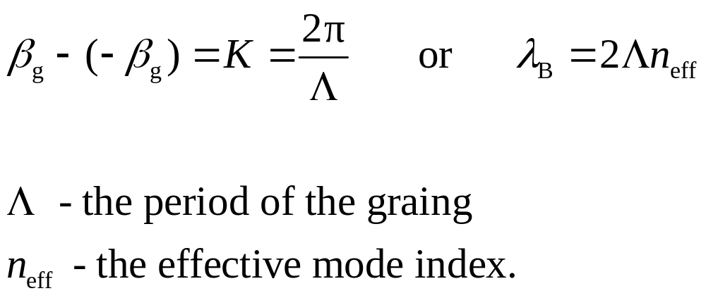
      Phase match condition
In the optic fibre communication window region (1.55 mm)
Typical L ~ 0.75 mm

Slide 7
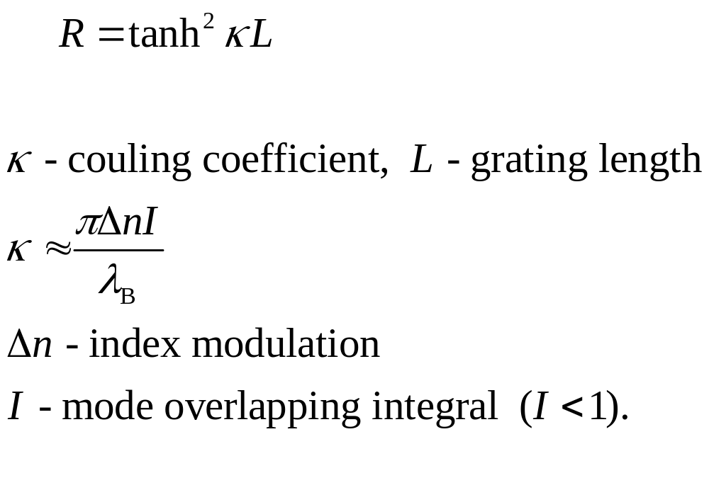
(a) Reflectivity

Slide 8
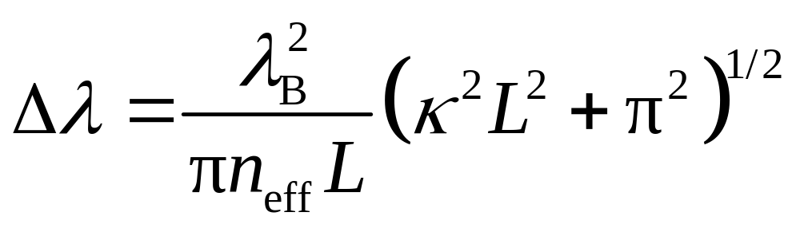
(b) Bandwidth
FWHM (3-dB) - full width at half maximum (typical 0.2-0.5nm).

Slide 9
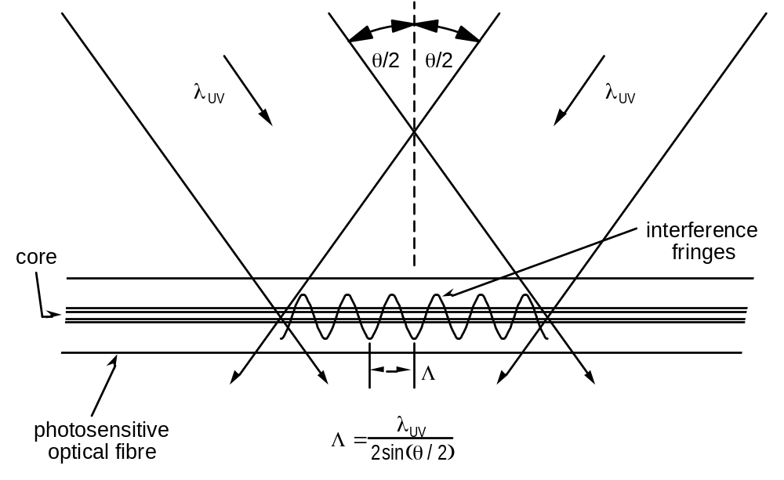
Fabrication of fibre Bragg gratings
(a) Two-beam holographic writing
(a)
50:50
beam splitter
Collimated
M2
UV laser
beam
Cylindrical
θ
/2
lens
M1
Cylindrical
Photosensitive
lens
fibre
θ
/2

Slide 10
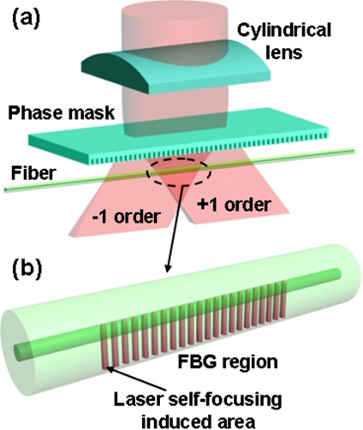
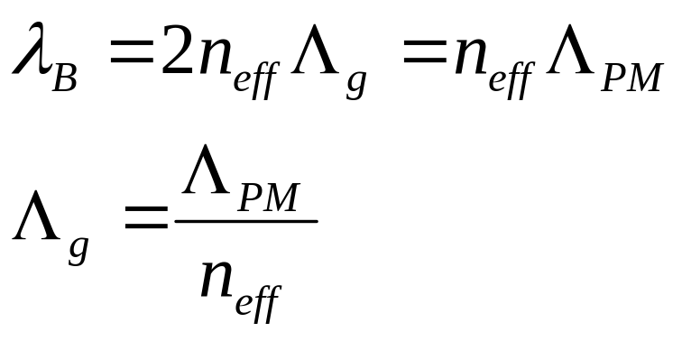
(b) Phase mask method

Slide 11
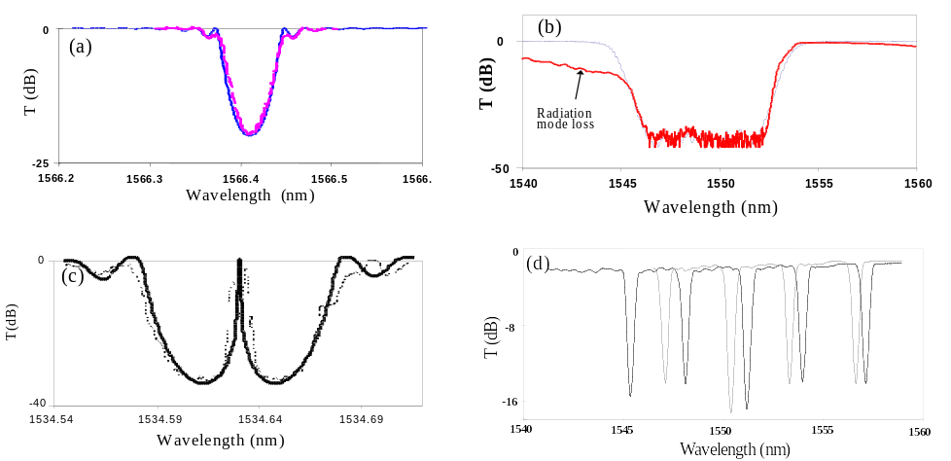
Complex grating structures
(a) uniform-period
(b) chirped
(c) bandpass (resonant)
(d) grating array

Slide 12
What properties FBG sensors can measure
Strain & Force
Temperature
Pressure
Displacement
Advanced fibre grating
based optical sensors
Vibration
Twist &Torsion
Level
detection
Current &
Magnetic field
Bending &
Loading
Chemicals &
Biochemicals
New parameters

Slide 13
For example:
Strain and temperature sensing
The sensing function of an FBG is related to the changes of both refractive index and grating period.
These changes are from externally applied mechanical and thermal perturbations, respectively.
Therefore, the peak reflected wavelength shifts Δλ_{Β} in response to change of strain Δε and temperature ΔT is given by

Slide 14
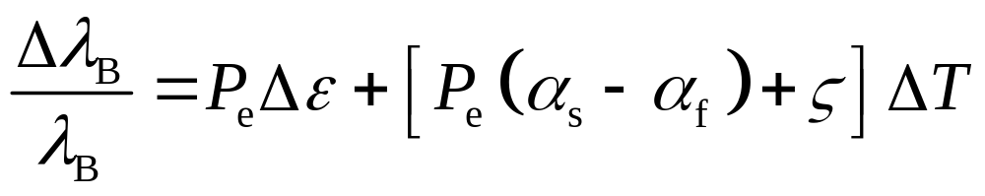
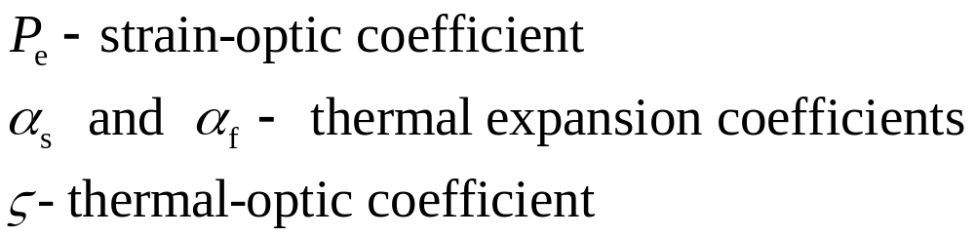

Slide 15
Advantages:
Coupler
Sensornet
Light Source
λ₁
λ₂
λ₃
λ₁
λ₂
λ₃
FBG sensor
λ
=2
n
Λ
Β
eff
Resolution: ~1pm/με and ~10pm/°C at 1500nm
  Inherently sensitive to strain and temperature
  Absolute, linear response
  Small size and light weight, stable and durable
  Immune to EM interference
  Operate in a wide range of environmental conditions
  Can be easily embedded
  Easy to multiplex (sensornet technology)
  Ideal candidates for SMART structure applications

Slide 16
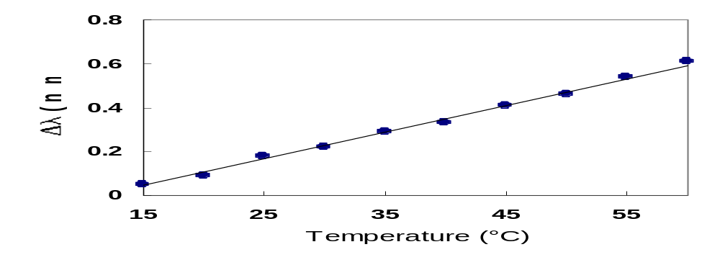
For grating produced in silica fibers, representative values of the strain- and temperature- induced wavelength shifts are ~1 pm/με and ~10 pm/°C at 1300 nm, respectively
Typical Bragg wavelength shift responses to the applied strain and temperature

Slide 17
Demodulation methods of the FBG based sensors
The method based on matched reference FBG
The method based on tunable laser
The method based on F-P filter

Slide 18
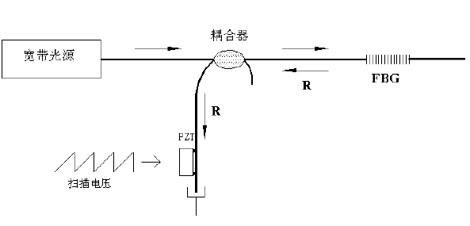
matched reference FBG
Coupler
Broadband source
Reference FBG
Scanning voltameter
PZT can control the center wavelength of the reference FBG.
When the center wavelength of reference FBG matches with the reflected wavelength, the light will transmit.

Slide 19
The demodulation method based on tunable laser
Optical filter
Bragg gratings with different wavelengths
Broad band source
The laser wavelength is tuned by controlling the filter.
Detector
Drive
Computer
Saw tooth drive voltage gives linear frequency scan
锯齿波形提供线性频率扫描
When the output wavelength from the tunable laser is same as the center wavelength of the Bragg gratings, the light will be detected.

Slide 20
The demodulation method based on F-P filter
Different F-P cavity lengths correspond to different transmission wavelength.
Bragg gratings at different wavelengths
Broad band source
Fabry Perot
filter
The F-P cavity length is controlled by the drive.
Drive
Detector
Computer
Saw tooth drive voltage gives linear frequency scan
When the transmission wavelength of the FP filter is same as the center wavelength of one of the Bragg gratings, the light will be detected.

Slide 21
Distributed fiber sensors
The distributed fiber sensors can be used to measure the temporal and spatial distributions of the physical quantities along fiber axis continuously.
Classification：
  Backward scattering type
  Transmission type
Here we mainly focus on the distributed fiber sensors based on backward scattering.

Slide 22
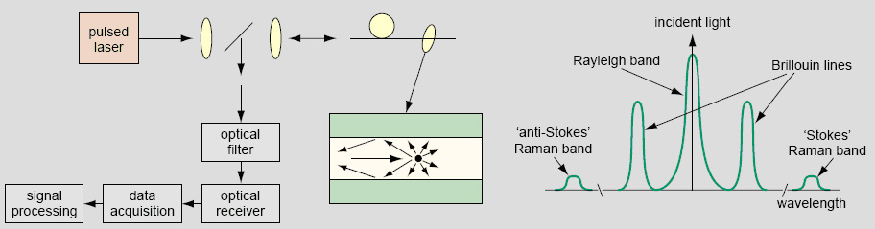
Distributed fiber sensors based on backward scattering
This type of sensors mainly utilize the backward scattering signal (e.g., Raleigh scattering, Raman scattering, Brillouin scattering) to realize the sensing.
Raleigh scattering—Intensity monitoring—Fiber loss-strain, stress
Raman scattering—Intensity monitoring—Temperature
Brillouin scattering—Frequency or intensity—Strain, stress, temperature
Applications: Gas pipe monitoring & Landslide and mud-rock flow monitoring

Slide 23
The detection techniques of distributed fiber sensors
光学时域/频域/时间相干检测技术
The technique based on optical temporal domain detection:
OTDR、POTDR、ROTDR、BOTDR
The technique based on optical frequency domain detection: OFDR、POFDR、ROFDR
The technique based on optical temporal coherence:
COTDR、ø- OTDR
Here we focus on the technique based on optical temporal domain detection

Slide 24
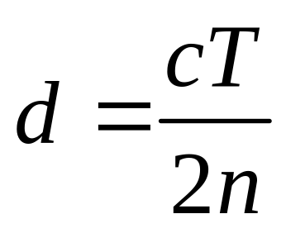
OTDR technique
This technique is performed by collecting the backward scattering light signals that are launching into the fiber.
The distance between the input and disturbance point can be obtained according to the time delay between the input and returned signals:
c is the light speed in vacuum, n is the refractive index, T is the time delay

Slide 25
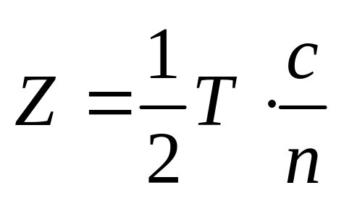
Time corresponds to distance
T
Optical
Pulsed
Z
∆l
Detector
Pulse launch
I
Oscilloscope
t
System can be operated from one end

Slide 26
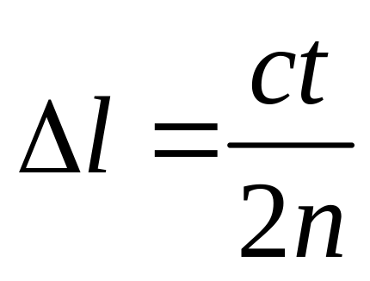
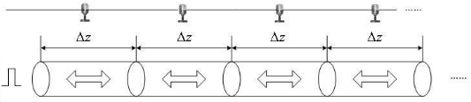
Spatial resolution of OTDR technique
空间分辨率
c is the light speed in vacuum, n is the refractive index, t is the pulse duration 脉冲持续时间

Slide 27
Distributed fiber sensors based on Raleigh scattering
Optical temporal domain detection techniques:
Common OTDR
Phase sensitive OTDR (φ-OTDR)
Coherent OTDR (COTDR)
Polarized OTDR (POTDR)

Slide 28
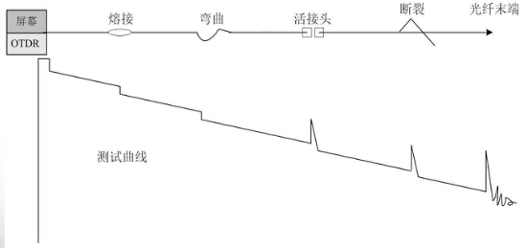
Common OTDR
It is usually used to measure or detect the loss and position of the fusion splice and connector.
This technique is very matured.
Fracture
Fusion splice
Screen
OTDR
Bending
Fiber end
Connector
Measurement curve

Slide 29
Distributed fiber sensors based on Raman scattering
This type of distributed fiber sensors are called as ROTDR.
ROTDR is usually applied in the temperature sensing at a large range and long distance
The relationship between the intensity ratio of Stokes light to anti-Stokes light and temperature is utilized to demodulate the signal.

Slide 30
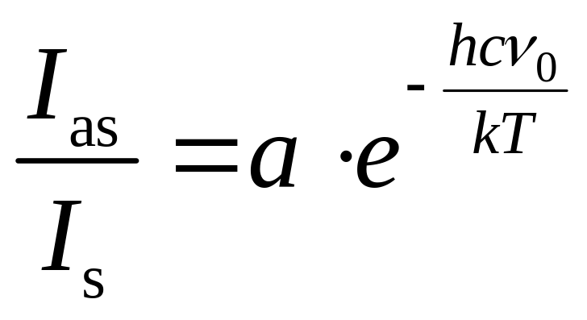
The principle of ROTDR
For the Raman scattered lights, the intensity of Stokes light is not relative to temperature, but the intensity of anti-Stokes light varied with temperature.
The intensity ratio of Stokes light I_{s} to anti-Stokes light I_{as} as a function of temperature can be expressed as
I_{as} changes
Temperature
changes
I_{s} no changes

Slide 31
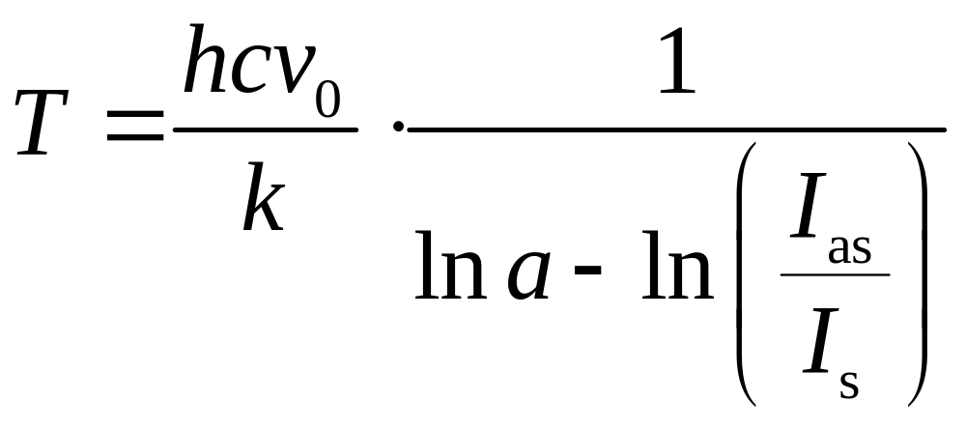
a is a coefficient relative to the temperature, h is the Plank constant, c is the light speed in vacuum, v₀ is the frequency of input light, k is the Boltzmann's constant, T is the absolute temperature
Therefore, the temperature can be calculated by measuring the intensity of Stokes and anti-Stokes lights

Slide 32
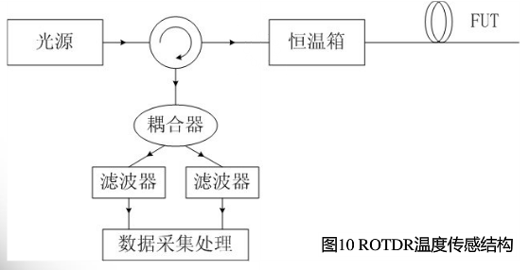
The structure of ROTDR used for temperature sensing
In practical, the filters can be used to obtain the Stokes and anti-Stoke lights, respectively.
Source
Thermotank
Coupler
Data collection and processing
Filter
Filter

Slide 33
Characteristics of ROTDR [与瑞利散射相比]
Intensity of Raman scattering is about 20~30 dBm lower than that of Raleigh scattering, thus high pulse peak power is required.
Intensity of Raman scattering is only relative to environment temperature, it is not sensitive to the strain.

Slide 34
Distributed fiber sensors based on Brillouin scattering
This type of distributed fiber sensors are called as BOTDR.
It detects the backward Brillouin scattering signals.
The Brillouin shifted light components are relative to the local temperature and strain.

Slide 35
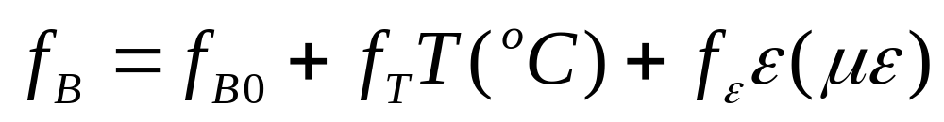
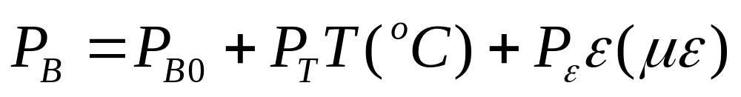
The temperature and strain will lead to the linear shift of the Brillouin frequency.
The power of the Brillouin light increases with the increased temperature and decreases with the increased strain.
The temperature and strain at one position can be achieved by measuring the Brillouin shift and the power of Brillouin scattered light.

Slide 36
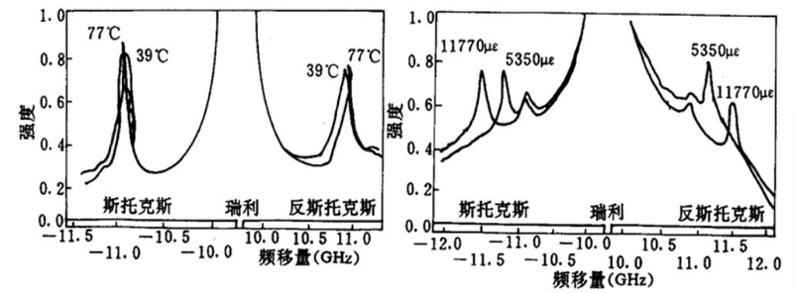
Intensity
Stokes
Raleigh
Anti-Stokes
At different temperatures
At different strains
Frequency shift (GHz)
Brillouin shift coefficients of temperature are 1.22 MHz/ºC (1310 nm) and 1 MHz/ºC (1550 nm).
Brillouin shift coefficients of strain are 581 MHz/% (1310 nm) and 493 MHz/% (1550 nm).
Compared to strain, temperature has a comparatively little influence on the Brillouin shift.

Slide 37
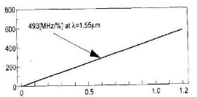
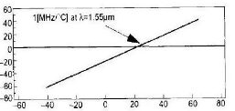
For example:
To obtain the strain and temperature by measuring the Brillouin shift @ 1550nm
Brillouin shift (MHz)
Strain (%)
Brillouin shift (MHz)
Temperature (⁰C)

Slide 38
Structure of BOTDR
BOTDR exploits the spontaneous Brillouin scattering.[自发布里渊散射]
Issues:
Intensity of Brillouin scattering signal is two order of magnitude smaller than that of Raleigh scattering signal, thus it is hard to detect. [功率较小，难以检测]
Brillouin scattering shift are general 11 GHz and also hard to take out from Raleigh scattering signal.
Therefore, the approach of frequency mixing between the local light and scattering light is employed to realize the coherent reception.
因此，采用局部光和散射光混频的方法实现相干接收。

Slide 39
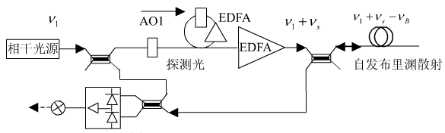
Demodulation of the BOTDR
For example: acousto-optic frequency shift method
Coherent source
AO2
Probe light
Spontaneous Brillouin scattering
Balanced optical heterodyne receiver
The frequency shift v_{s} from AOs is almost same as the Brillouin shift v_{B} , thus the frequency of the backward Brillouin scattering light is close to that of the reference light.
Therefore the frequency difference is just located at the frequency bandwidth range of the optical heterodyne receiver. [光外差接收器]

Slide 40
Intensity
Changing the AO frequency shift
Frequency shift
Brilouin frequency spectrum can be obtained at the balanced optical heterodyne receiver.
The peak corresponds to the center of the Brillouin frequency shift.

